Slide 1
Shropshire Local Plan Review Consultation on Preferred Sites
November 2018
Eddie West – Principal Policy Officer

Slide 2
Local Plan Review
Up to date Local Plan is a statutory requirement;
Review will conform with national policy
Review will maintain local management over planning decisions to 2036;
Still in Pre-Submission consultation stage
‘Final Plan’ - expected late 2019
Independent Examination - 2019
Adoption - Late 2020

Slide 3
Scope of Preferred Options
Outlines a housing policy direction to improve the delivery of local housing needs;
Establishes development guidelines and development boundaries for Shrewsbury, Principal and Key Centres and each proposed Community Hub;
Sets out the preferred sites to deliver the preferred scale and distribution of housing and employment growth during the period to 2036;

Slide 4
Proposed Growth: Shropshire
Key Proposals:
‘High’ housing growth of 28,750 dwellings, equivalent to an average delivery rate of 1,430 dwellings per year for the whole of Shropshire;
Existing housing completions, commitments and allocations amount to around 18,500 dwellings, so the net additional housing now required is around 10,250 dwellings;
Balanced employment growth to deliver around 300 hectares of employment development at an average rate of 15 hectares of employment land per year;
The existing employment land supply amounts to 223ha, giving a net requirement for around 80ha of new employment land. However, this is a minimum requirement and some additional land over and above this minimum is likely to be needed;

Slide 5
Preferred Strategy: Shrewsbury
Key Proposals 2016-2036:
Housing –
Employment –
 | Number of Dwellings
Preferred dwelling guideline 2016-2036 | 8,625
Dwellings completed in 2016-17* | 733
Dwellings committed as at 31st March 2017* | 4,246
Remaining dwelling requirement to be identified | 3,646
Dwellings to be allocated | 2,150
Balance/Windfall allowance** | 1,496
 | Employment Land (Ha)
Preferred employment land guideline 2016-2036 | 91
Commitments and allocations as at 31st March 2017* | 41
Employment land shortfall | 50
Employment land to be allocated | 65
Balance/Windfall allowance** | 0

Slide 6
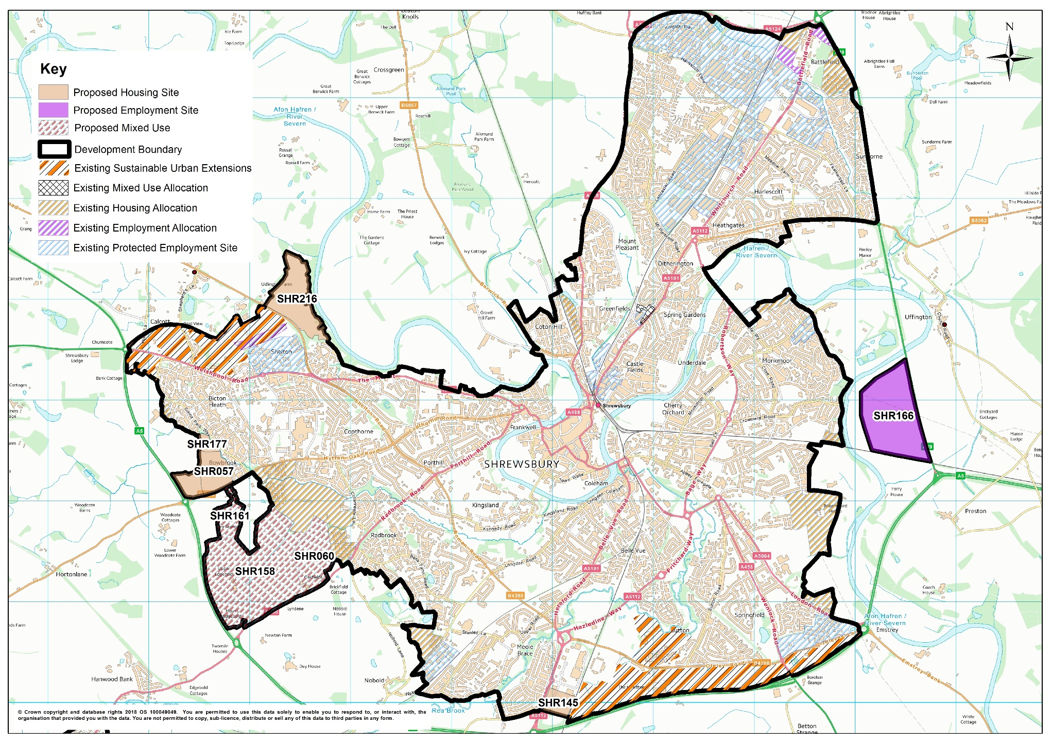
Shrewsbury: Preferred Sites

Slide 7
Shrewsbury: Preferred Sites
Site Reference | Site Location | Site Area (Ha) | Approximate Capacity
SHR158/ (part) SHR060/ SHR161 | Land between Mytton Oak Road and Hanwood Road, Shrewsbury | Approx. 40ha (residential) Approx. 20ha (commercial) Approx.35ha (green spaces, community uses, other on-site infrastructure) | 1,200 dwellings
SHR057 (part) / SHR177 | Land North of Mytton Oak Road, Shrewsbury | Approx. 25ha | 500 dwellings
SHR216 | Land at Holyhead Road, Shrewsbury | Approx. 23ha | 300 dwellings
SHR145 | Land South of Meole Brace Retail Park, Shrewsbury | Approx. 6ha | 150 dwellings
SHR166 | Land to the west of the A49, Shrewsbury | Approx. 45ha | 18 hectares of employment land

Slide 8
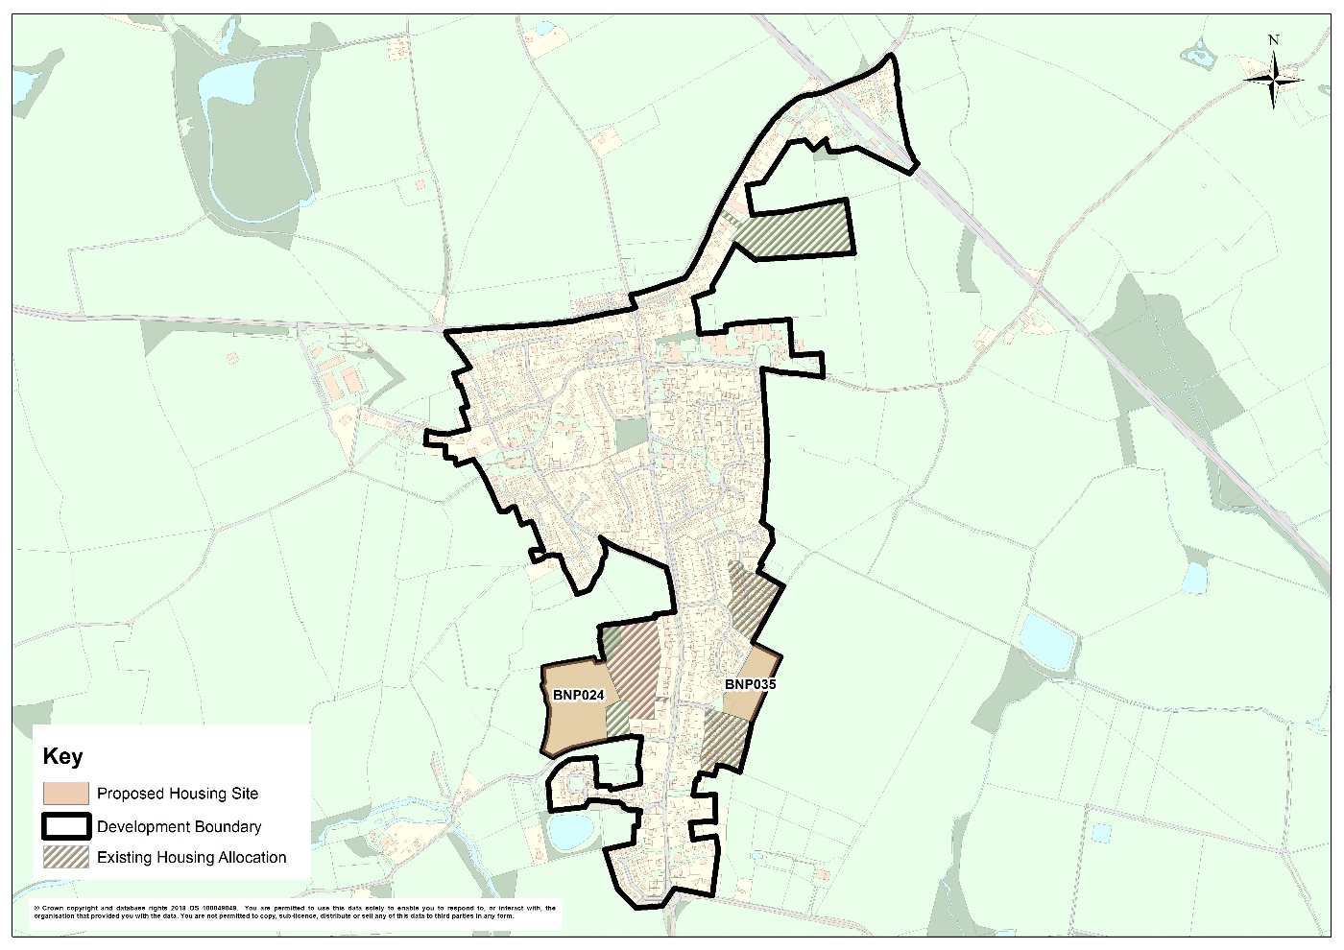
Development Strategy: Baschurch
 | Number of Dwellings
Preferred dwelling guideline 2016-2036 | 360
Dwellings completed in 2016-17* | 48
Dwellings committed as at 31st March 2017* | 224
Remaining dwelling requirement to be identified | 88
Dwellings to be allocated | 55
Balance/Windfall allowance** | 33

Slide 9
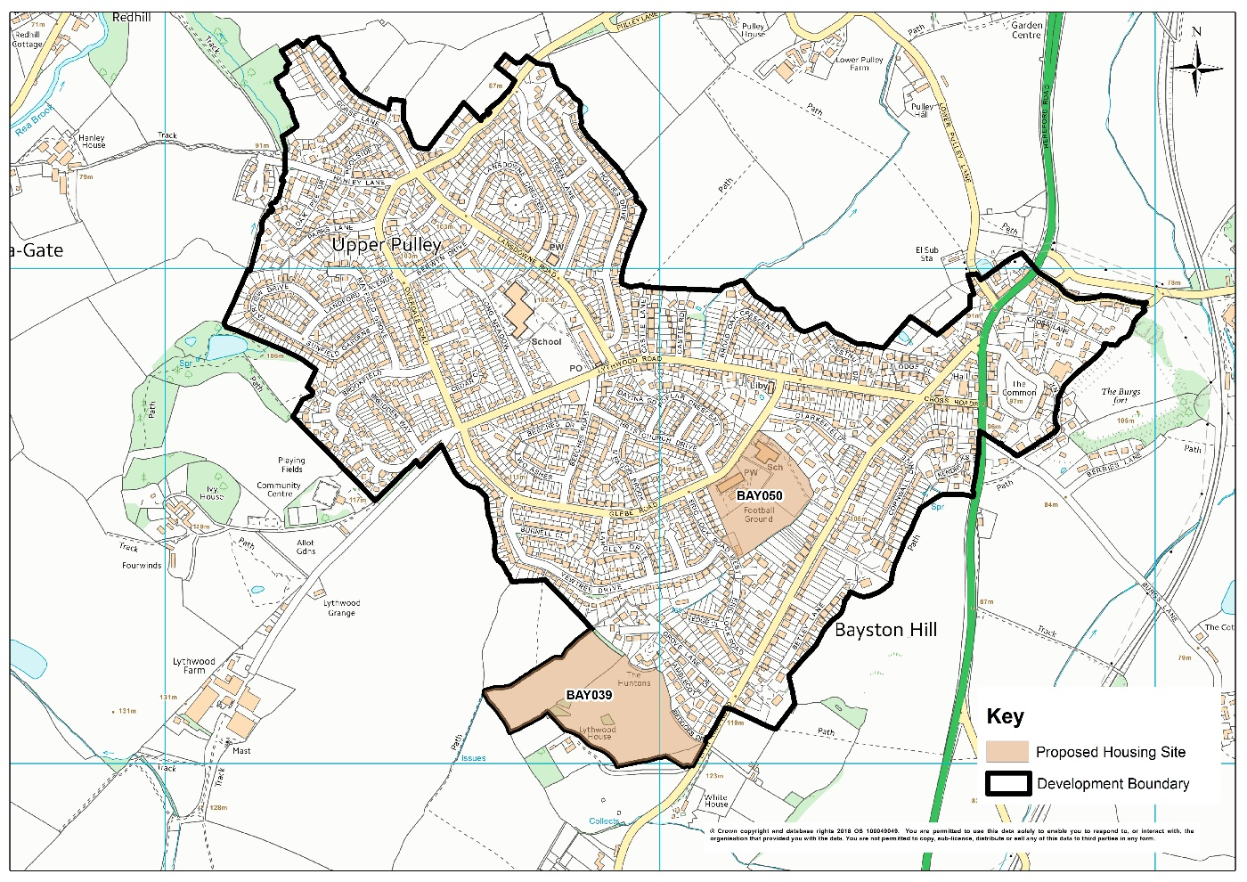
Development Strategy: Bayston Hill
 | Number of Dwellings
Preferred dwelling guideline 2016-2036 | 200
Dwellings completed in 2016-17* | 10
Dwellings committed as at 31st March 2017* | 19
Remaining dwelling requirement to be identified | 171
Dwellings to be allocated | 150-160
Balance/Windfall allowance** | 11-21

Slide 10
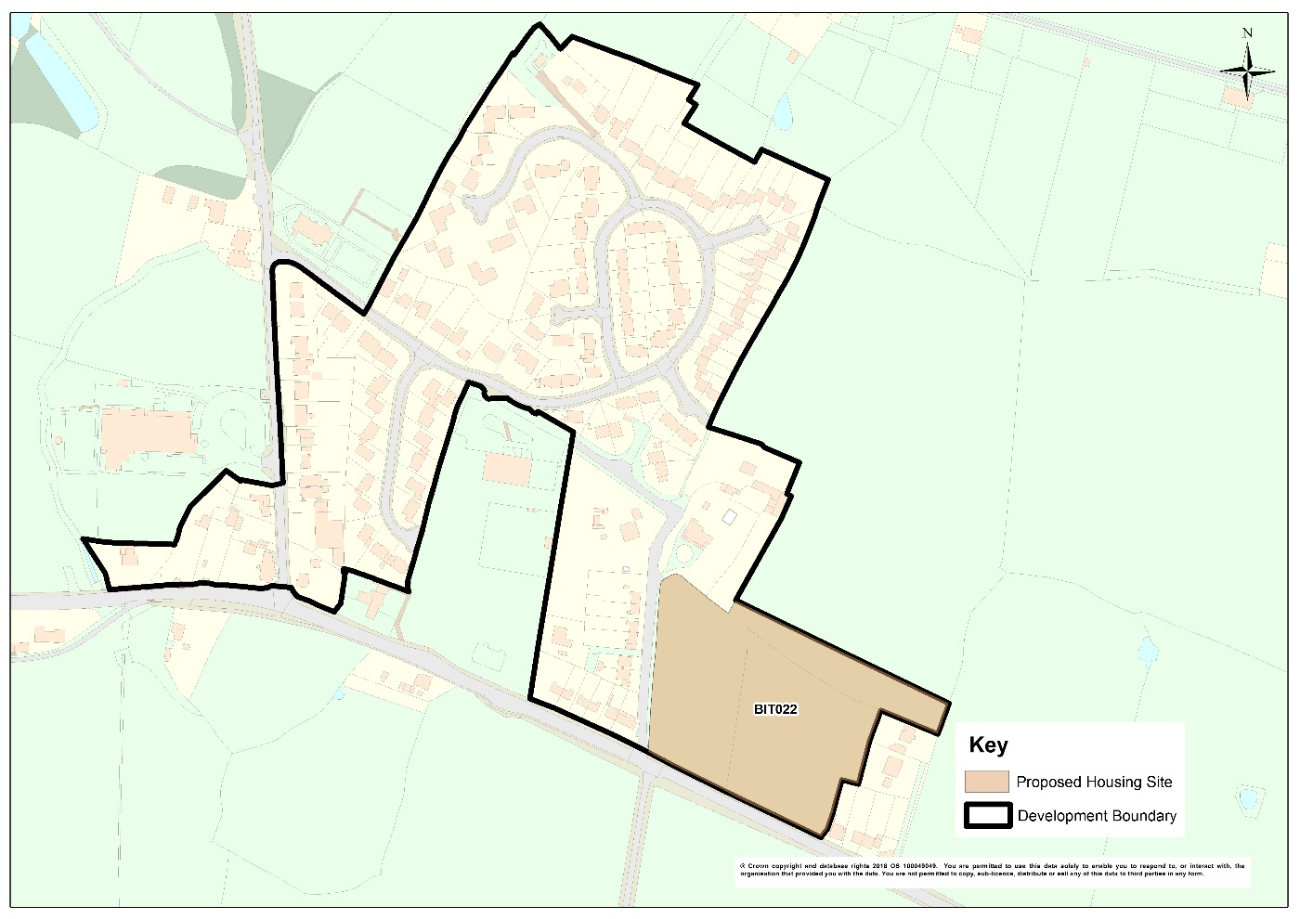
Development Strategy: Bicton
 | Number of Dwellings
Preferred dwelling guideline 2016-2036 | 30
Dwellings completed in 2016-17* | 1
Dwellings committed as at 31st March 2017* | 2
Remaining dwelling requirement to be identified | 27
Dwellings to be allocated (Land East of Villa Farm) | 15
Balance/Windfall allowance** | 12

Slide 11
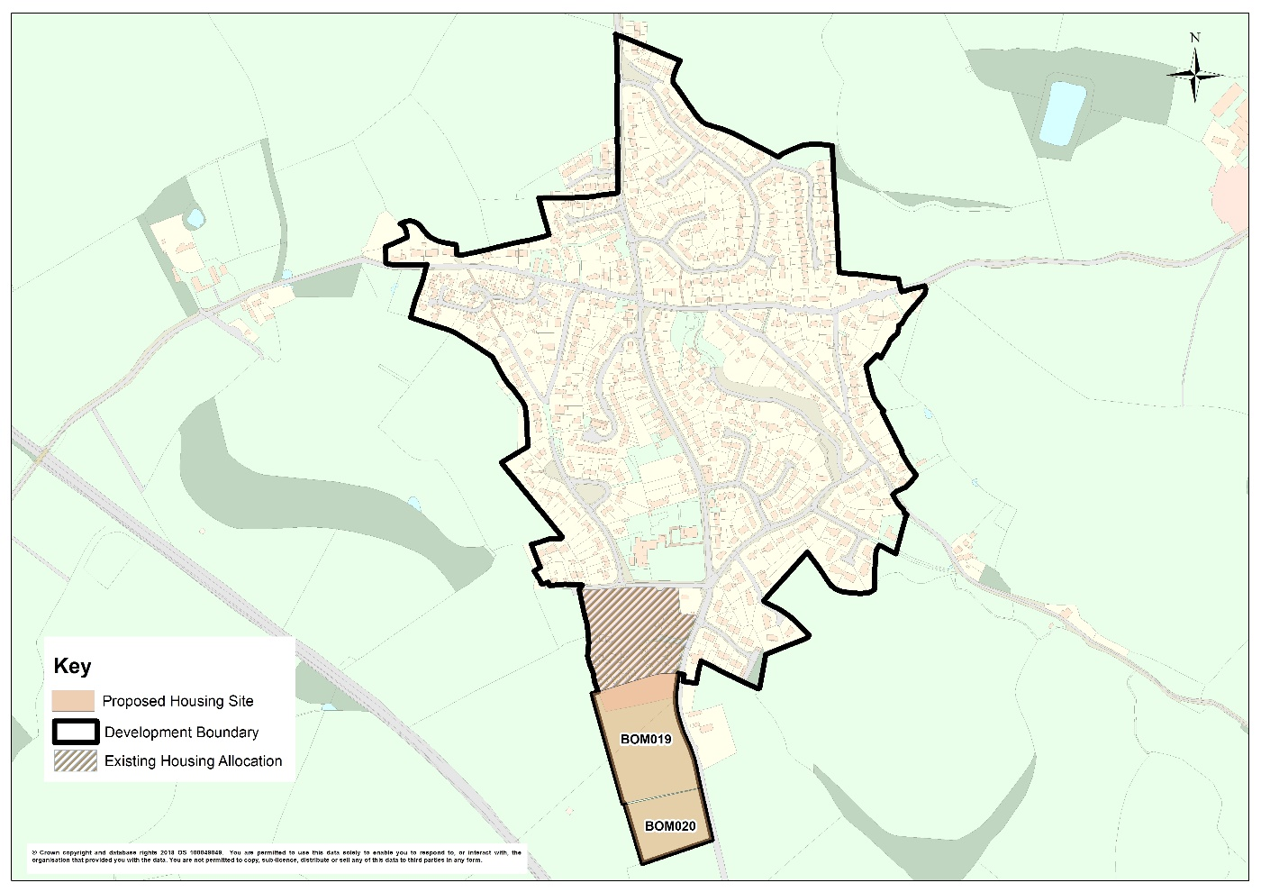
Development Strategy: Bomere Heath
 | Number of Dwellings
Preferred dwelling guideline 2016-2036 | 110
Dwellings completed in 2016-17* | 0
Dwellings committed as at 31st March 2017* | 40
Remaining dwelling requirement to be identified | 70
Dwellings to be allocated | 55
Balance/Windfall allowance** | 15

Slide 12
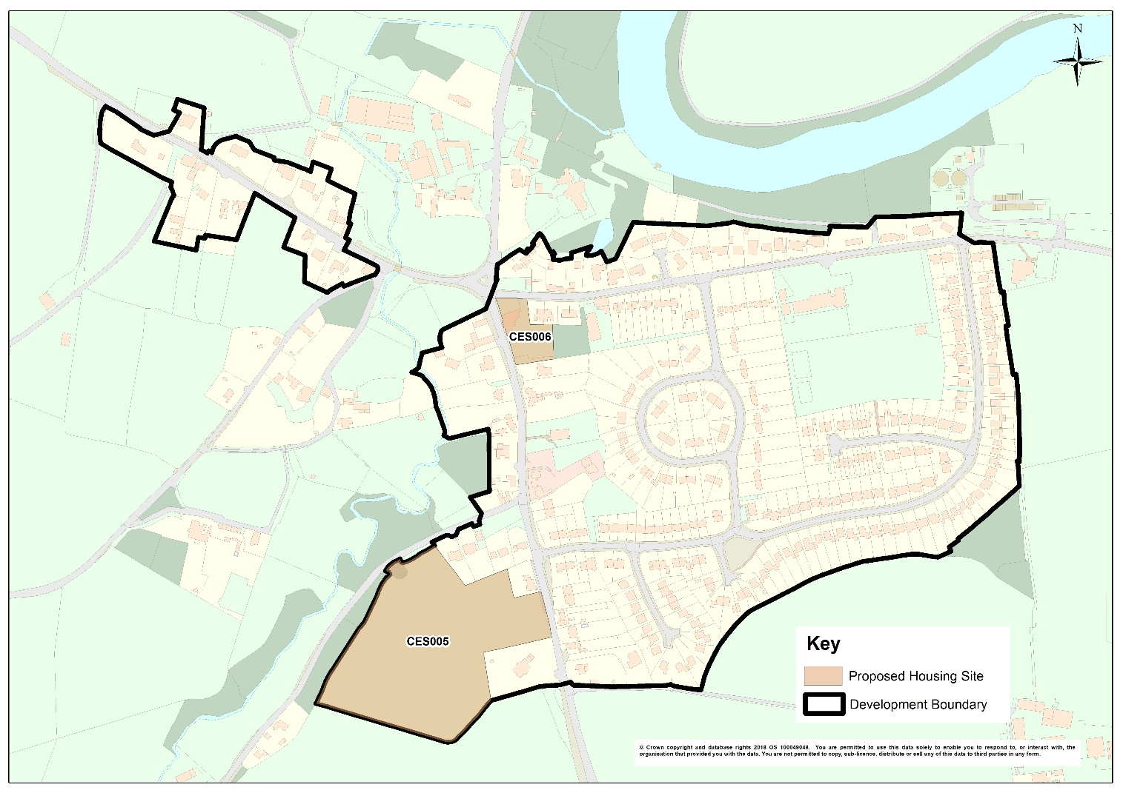
Development Strategy: Cressage
 | Number of Dwellings
Preferred dwelling guideline 2016-2036 | 80
Dwellings completed in 2016-17* | 0
Dwellings committed as at 31st March 2017* | 2
Remaining dwelling requirement to be identified | 78
Dwellings to be allocated | 65
Balance/Windfall allowance** | 13

Slide 13
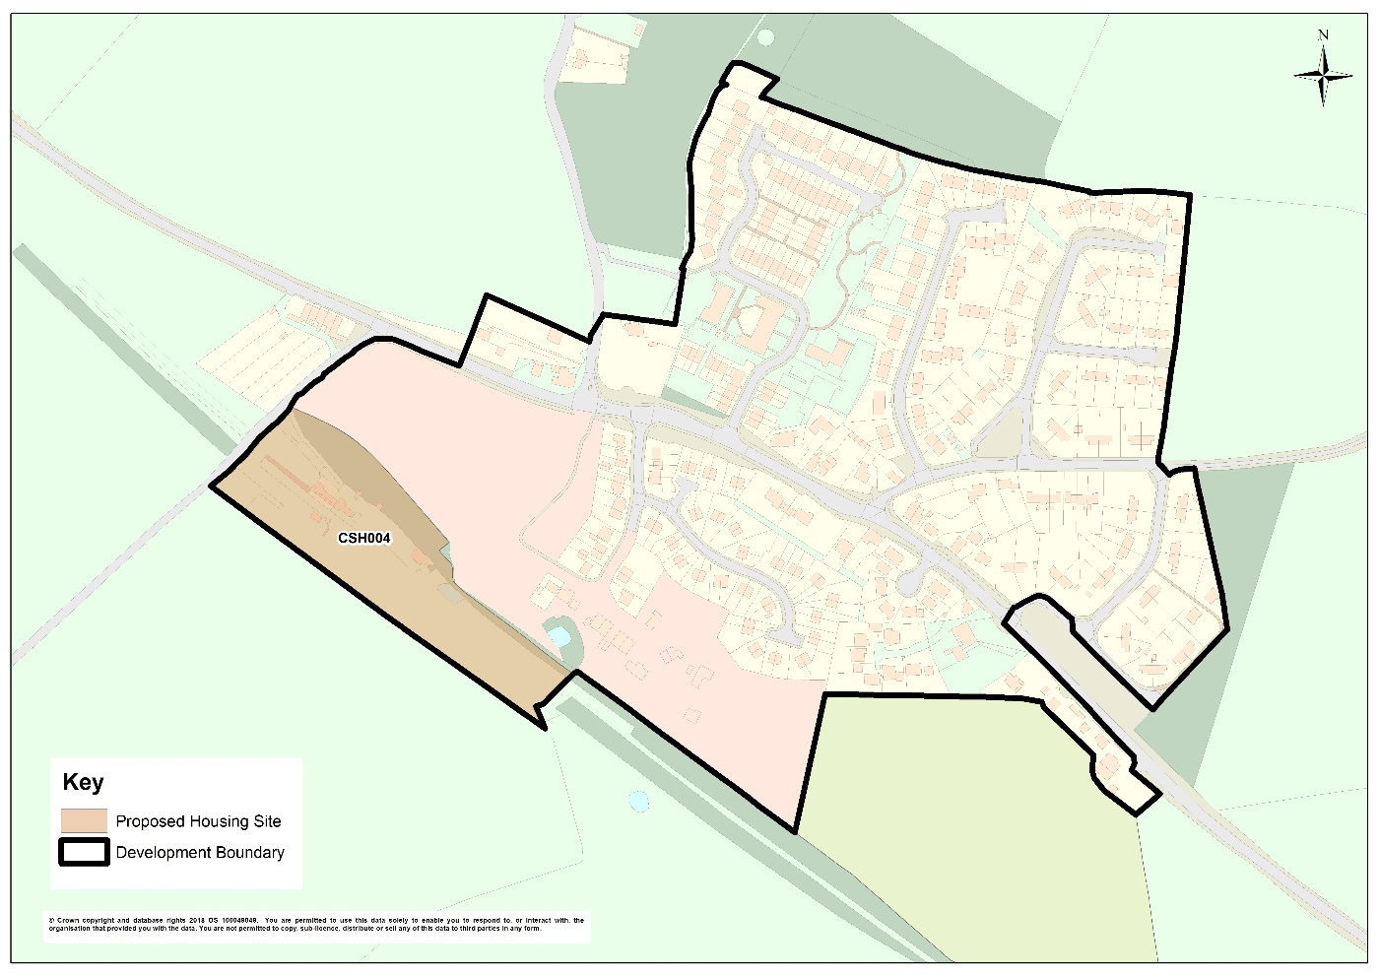
Development Strategy: Cross Houses
 | Number of Dwellings
Preferred dwelling guideline 2016-2036 | 130
Dwellings completed in 2016-17* | 0
Dwellings committed as at 31st March 2017* | 78
Remaining dwelling requirement to be identified | 52
Dwellings to be allocated | 40
Balance/Windfall allowance** | 12

Slide 14
Development Strategy: Dorrington
 | Number of Dwellings
Preferred dwelling guideline 2016-2036 | 150
Dwellings completed in 2016-17* | 13
Dwellings committed as at 31st March 2017* | 64
Remaining dwelling requirement to be identified | 69
Dwellings to be allocated | To be determined in the Condover Neighbourhood Plan
Balance/Windfall allowance** | To be determined in the Condover Neighbourhood Plan

Slide 15
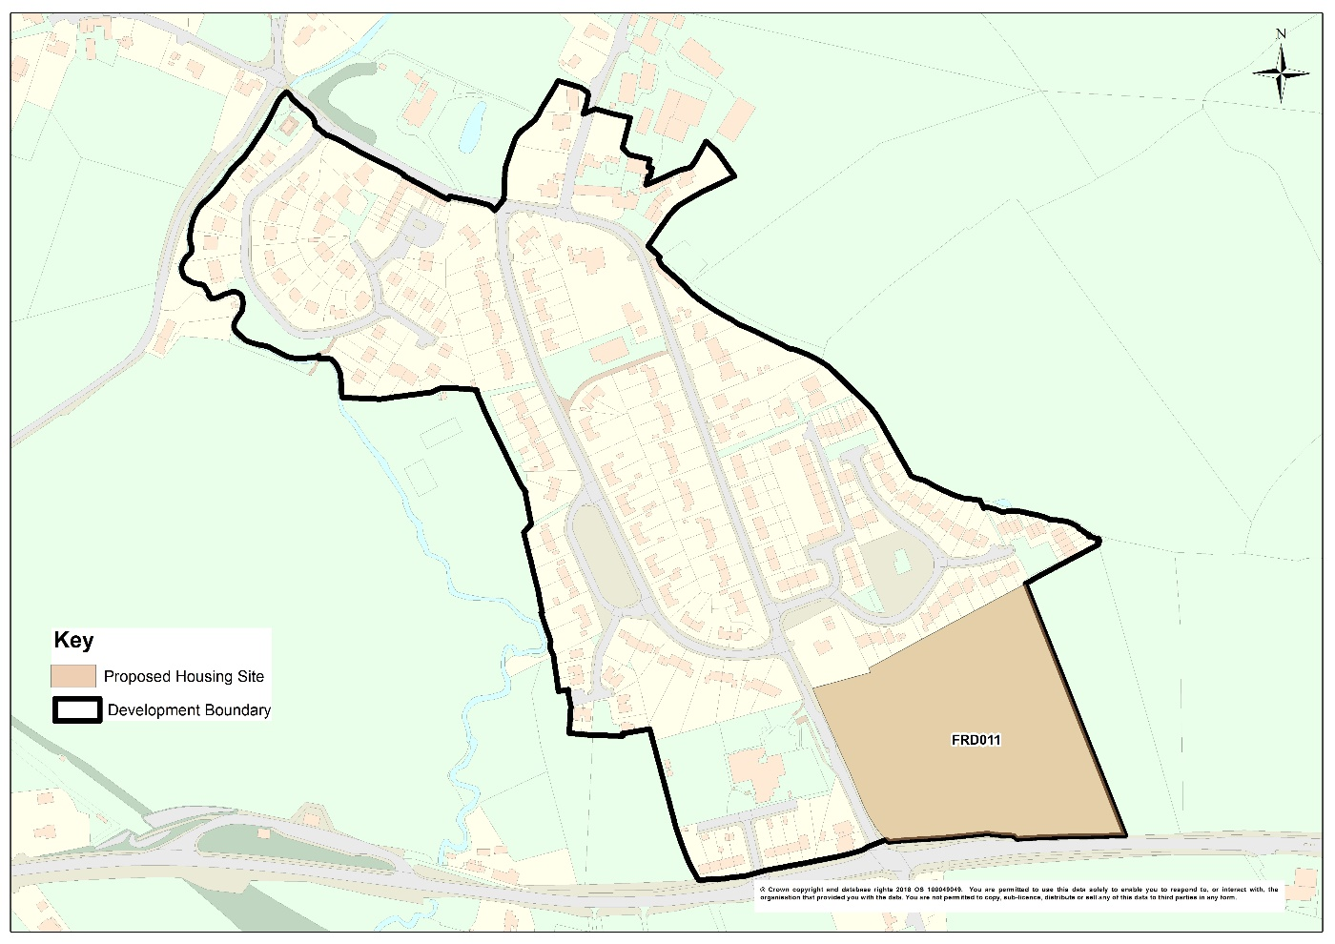
Development Strategy: Ford
 | Number of Dwellings
Preferred dwelling guideline 2016-2036 | 100
Dwellings completed in 2016-17* | 3
Dwellings committed as at 31st March 2017* | 28
Remaining dwelling requirement to be identified | 69
Dwellings to be allocated | 50
Balance/Windfall allowance** | 19

Slide 16
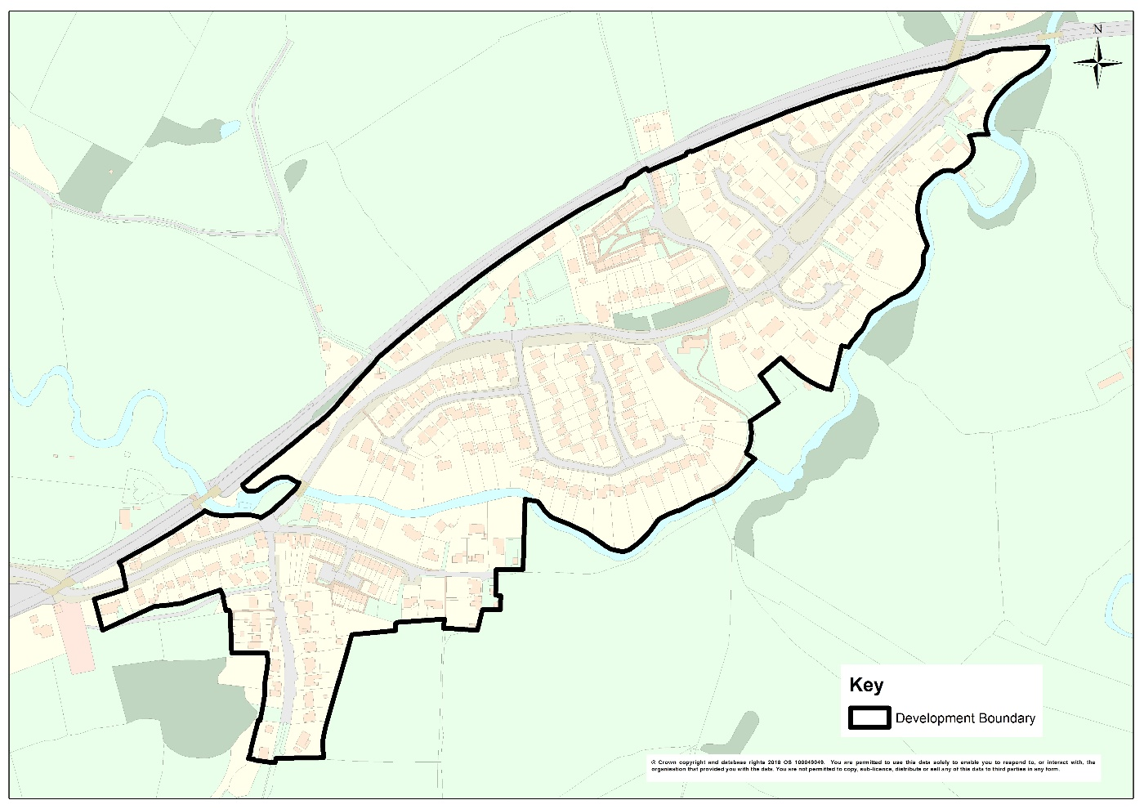
Development Strategy: Hanwood
 | Number of Dwellings
Preferred dwelling guideline 2016-2036 | 50
Dwellings completed in 2016-17* | 0
Dwellings committed as at 31st March 2017* | 35
Remaining dwelling requirement to be identified | 15
Dwellings to be allocated | 0
Balance/Windfall allowance** | 15

Slide 17
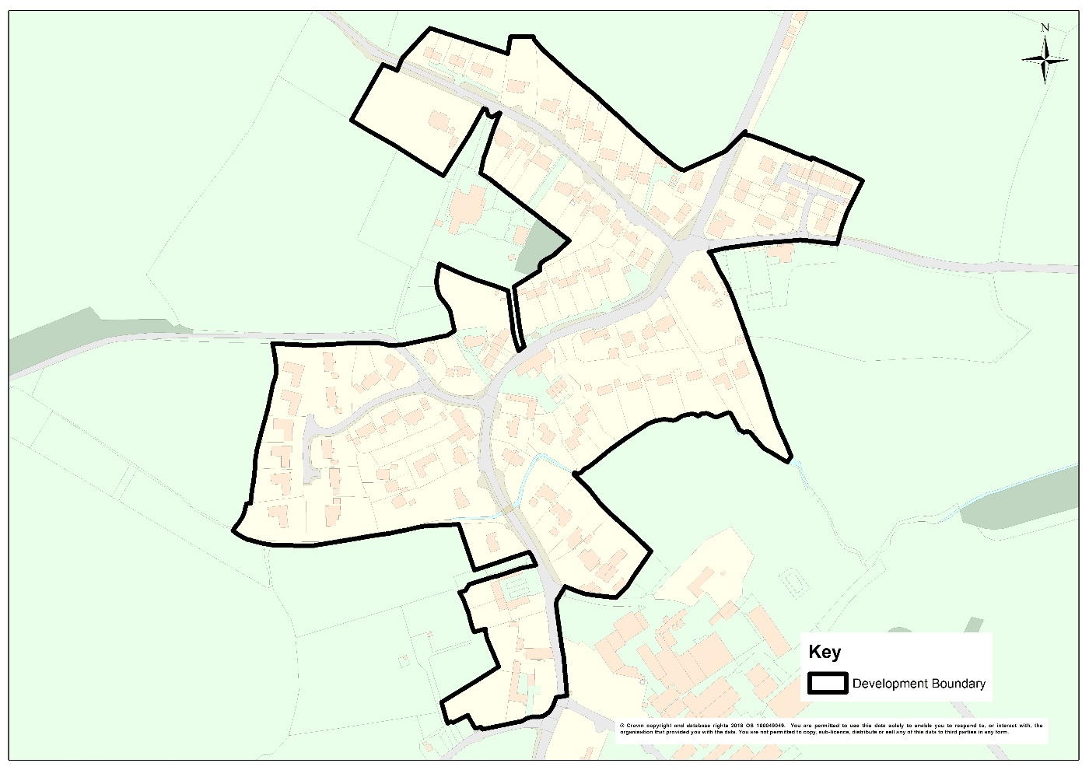
Development Strategy: Longden
 | Number of Dwellings
Preferred dwelling guideline 2016-2036 | 50
Dwellings completed in 2016-17* | 14
Dwellings committed as at 31st March 2017* | 12
Remaining dwelling requirement to be identified | 24
Dwellings to be Allocated | 0
Balance** | 24

Slide 18
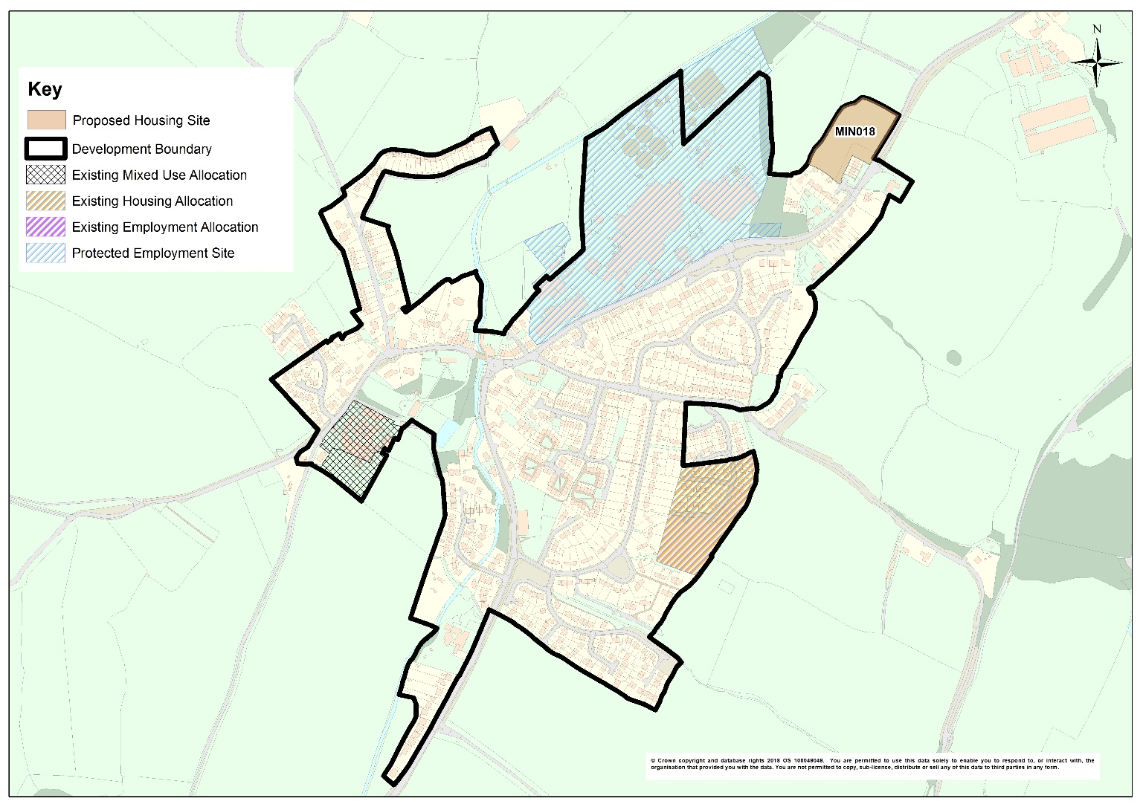
Development Strategy: Minsterley
 | Number of Dwellings
Preferred dwelling guideline 2016-2036 | 155
Dwellings completed in 2016-17* | 24
Dwellings committed as at 31st March 2017* | 89
Remaining dwelling requirement to be identified | 42
Dwellings to be allocated | 20
Balance/Windfall allowance** | 22

Slide 19
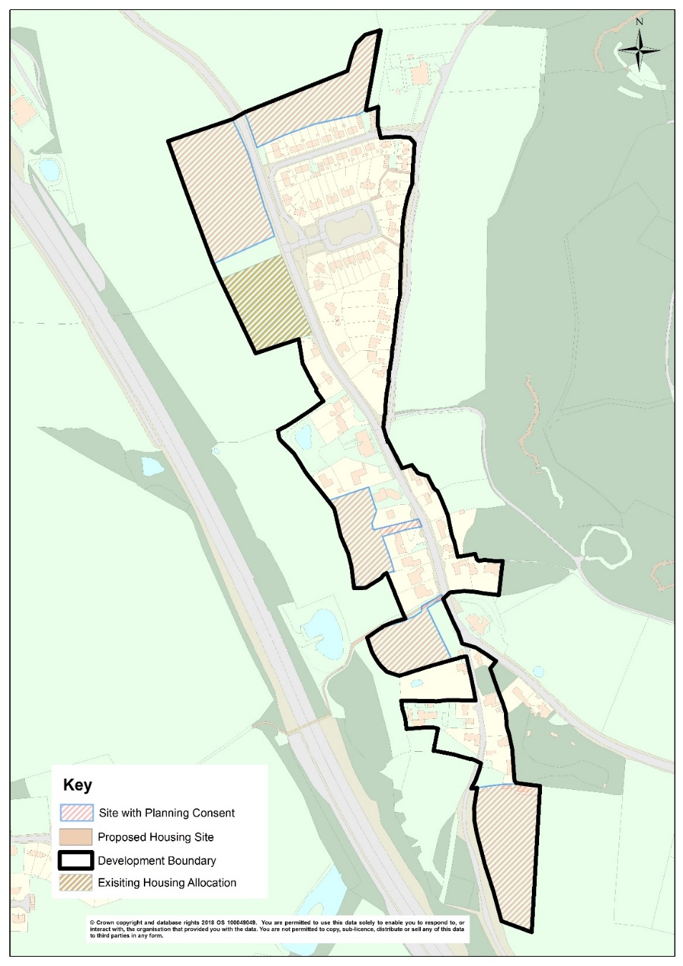
Development Strategy: Nesscliffe
 | Number of Dwellings
Preferred dwelling guideline 2016-2036 | 120
Dwellings completed in 2016-17* | 1
Dwellings committed as at 31st March 2017* | 105
Remaining dwelling requirement to be identified | 14
Dwellings to be Allocated | 0
Balance** | 14

Slide 20
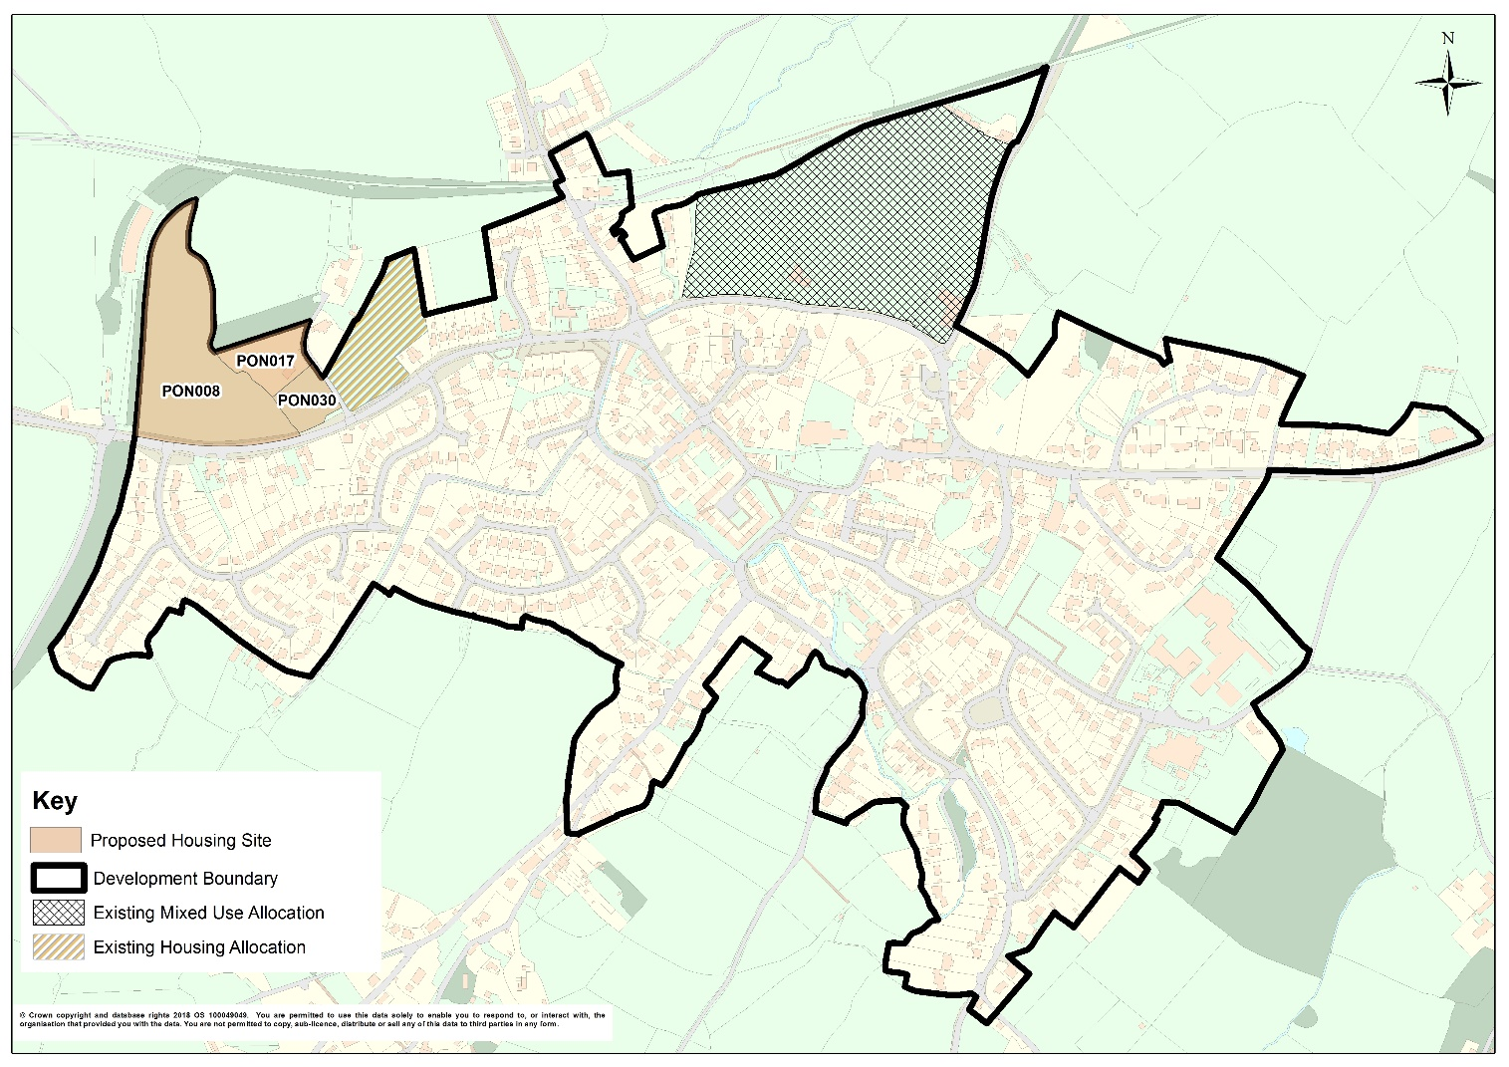
Development Strategy: Pontesbury
 | Number of Dwellings
Preferred dwelling guideline 2016-2036 | 175
Dwellings completed in 2016-17* | 7
Dwellings committed as at 31st March 2017* | 106
Remaining dwelling requirement to be identified | 62
Dwellings to be allocated | 40
Balance/Windfall allowance** | 22

Slide 21
Other Proposals
Proposed Community Clusters:
Albrighton
Four Crosses
Grafton and Newbanks
Hook-a-gate, Annscroft and Longden Common
Montford Bridge
Uffington
Infill schemes / affordable housing exception sites may be appropriate; No development boundary / no specific housing guideline

Slide 22
Consultation
Cabinet agreed the document for consultation on 7th November
Consultation to run between 29th November and 31st January
SALC Meetings / LJCs /

